Slide 1
M7 Sub & CS Review
Zhang Hao

Slide 2
Content
M7 Subsystem
Diagram
Introduction
CS
Diagram
Introduction
SIM

Slide 3
M7sub - Diagram

Slide 4
M7sub – M7core
Parameter | Value | Description
ITCM | 128KB | Itcm size
DTCM | 64KB | Dtcm size
ICACHE | 16KB | Icache size
DCACHE | 16KB | Dcache size
FPU | 2 | Both single & double precision
ETM | 2 | Data & Instruction
INITVCTOR | Register | Configured by register
INT NUM | 160 | Interrupt number

Slide 5
M7sub – QSPI

Slide 6
M7sub – QSPI
Mem/Reg Definition
cmd mem (APB)
intr high/low mem (APB)
cmd addr mem (APB)
rd/wr inst high/low reg (AHB)
Used to active SPI command
Reconfigure the instruction word
Configure the addr needed by SPI cmd
Reconfigure the instruction word (rd/wr)
sel
instruction word

Slide 7
M7sub – QSPI
High word =
{
bus width, //2 bits
Mode bit width, //2 bits
Tag, //1 bit, 0-APB, 1-AHB
Dir, //1 bit, 0-Read, 1-Write
Cmd bit width, //2 bits
Cmd, //8 bits
Mode cycle //3 bits
}
*bit width : 00-1bit, 01-2bit, 10-4bit 11-reserved
Instruction Structure
High Word (19bit)
Low Word (32bit)
Address (32bit)
Data (32bit)
Low word =
{
mode, //2 bits
Dummy cycle, //5 bits
Data bit width, //2 bits
Data cycle, //9 bits
Addr bit width, //2 bits
Addr cnt sel, //2 bits <address bits switch>
Cmd quad mode, //1 bit
Addr quad mode, //1 bit
Mode quad mode, //1 bit
Data quad mode //1 bit
}
*bit width : 00-1bit, 01-2bit, 10-4bit 11-reserved

Slide 8
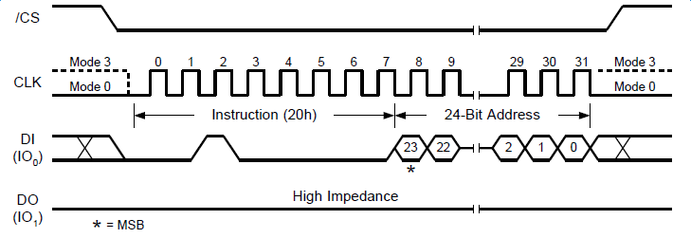
M7sub – QSPI
inst_high =
{
2’b0, //bus width, //2 bits
2’b0, //Mode bit width, //2 bits
1’b0, //Tag, //1 bit, 0-APB, 1-AHB
1’b1, //Dir, //1 bit, 0-Read, 1-Write
2’b0, //Cmd bit width, //2 bits
8’h20, //Cmd, //8 bits
3’b0 //Mode cycle //3 bits
}
Instruction Structure
20h – sector erase
Inst_low =
{
2’b0, //mode, //2 bits
5’b0, //Dummy cycle, //5 bits
2’b00, //Data bit width, //2 bits
9’b0, //Data cycle, //9 bits
2’b0, //Addr bit width, //2 bits
2’b01, //Addr cnt sel, //2 bits <address bits switch>
1’b0, //Cmd quad mode, //1 bit
1’b0, //Addr quad mode, //1 bit
1’b0, //Mode quad mode, //1 bit
1’b0 //Data quad mode //1 bit
}
cmd: 20h
addr: 24bit
Others : no

Slide 9
M7sub – QSPI
Operation Flow

Slide 10
M7sub – Peripheral with DMA
Simple Diagram

Slide 11
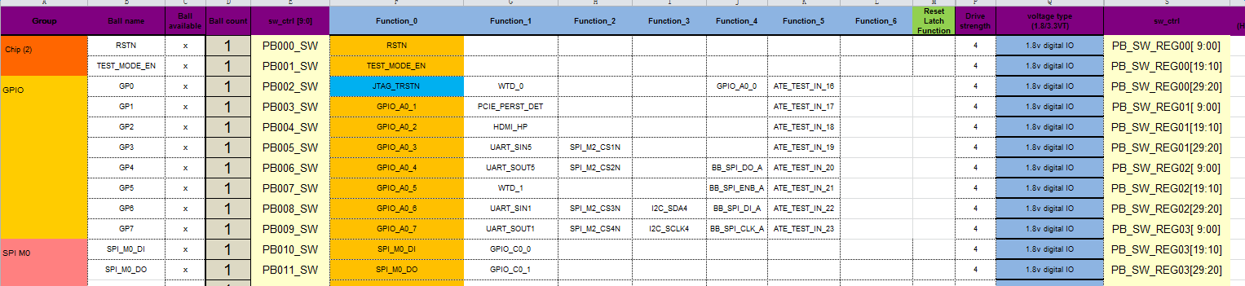
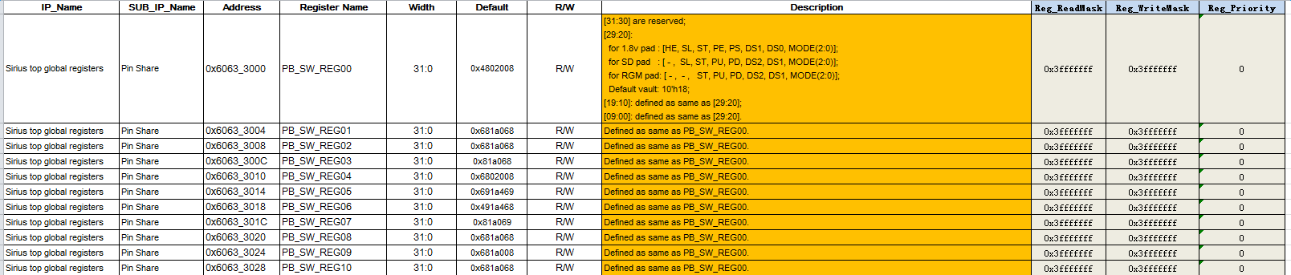
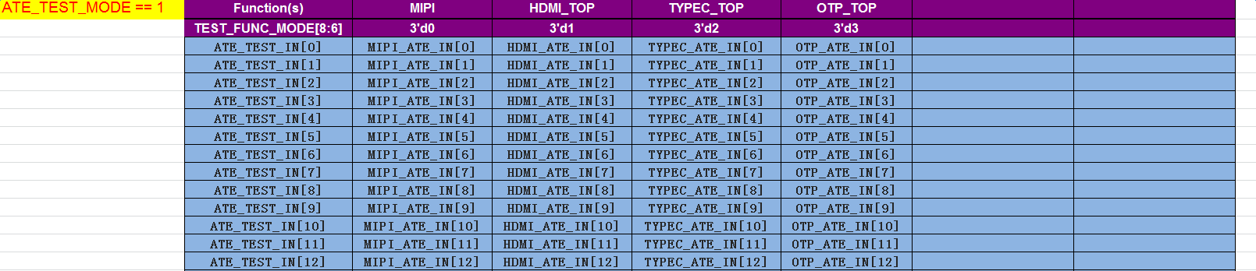
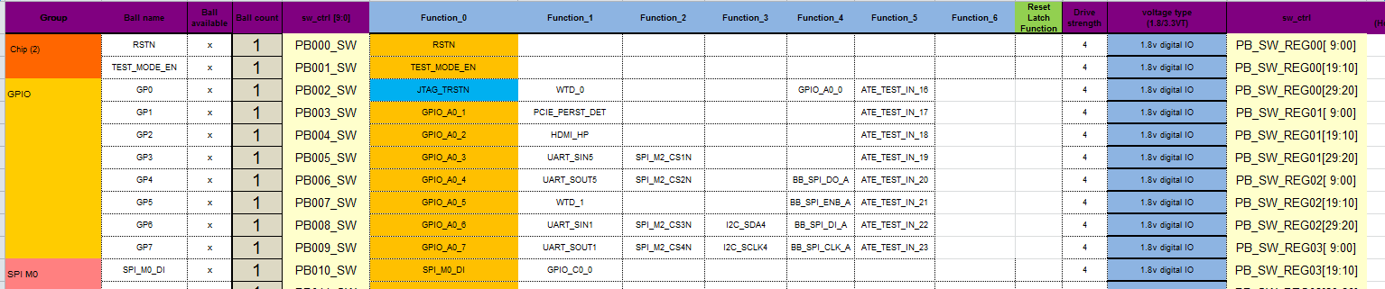
M7sub – Pin Share
How to use?
sirius_pins_vxxx.xlsx
sirius_top_global_register.xlsx
pin_share.c

Slide 12
CoreSight - Diagram
1. Access Part
2. TimeStamp
3. Trigger Control Part
4. Trace Source
5. Trace Link
6. Trace Sink
7. APB Interconnect Bus

Slide 13
CoreSight - DAP

Slide 14
CoreSight - APBIC

Slide 15
CoreSight – Rom Table

Slide 16
CoreSight – Trigger

Slide 17
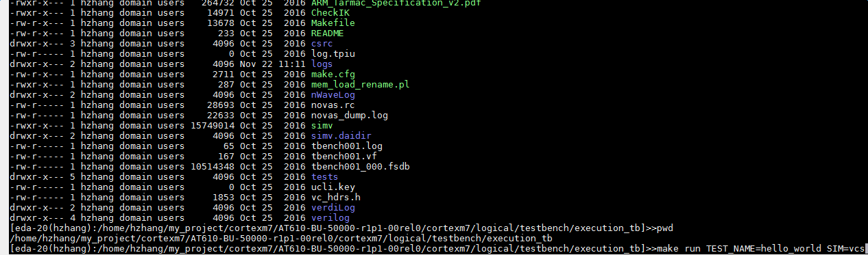
M7Sub - Sim
Local env
execution_tb
( config_check / itm_trace / etm_trace / mpu / reset / rom_table / debug / interrupt ect. )

Slide 18
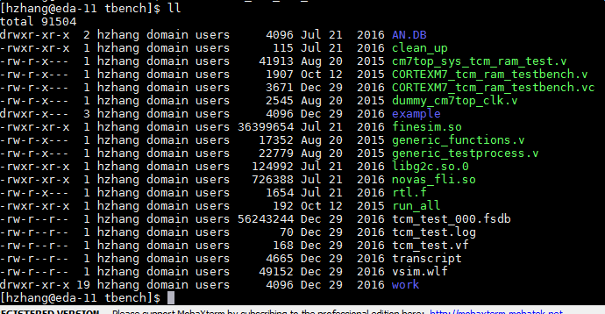
M7Sub - Sim
Local env
ram_integration_tb
( Icache / Dcache / ITCM / DTCM )

Slide 19
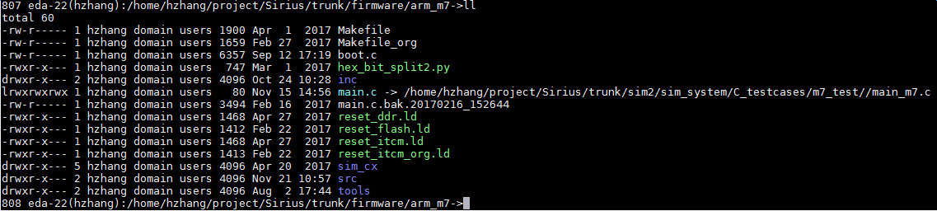
M7Sub - Sim
SoC env

Slide 20
CoreSight - Sim

Slide 21
CoreSight - Sim
hello_world
discovery
ram_integration
memap_check
partlibcheck
cxsystem_check
cti_channel
7/14 = 50%

Slide 22
Q&A
Thanks. Q&A

